Slide 1
Curious George H.A. Rey Old Wire Road Elementary Kindergarten

Slide 2
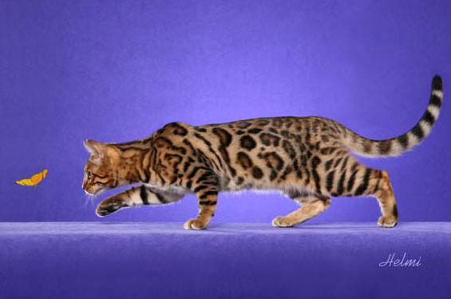
Curious
Interested in knowing about something
The cat was curious about the butterfly.

Slide 3
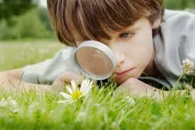
fascinated
Interested in something; holding someone’s attention
The boy was fascinated with the green grass.

Slide 4
whisked
To brush off; to move quickly
The girl was whisked away.

Slide 5
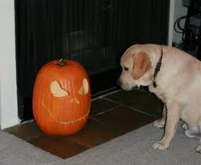
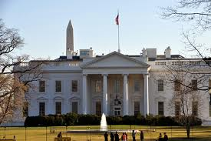
Which goes with curious?

Slide 6
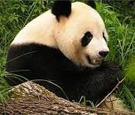
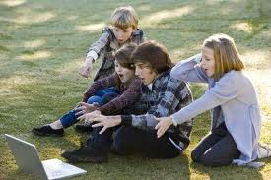
Which goes with fascinated?

Slide 7
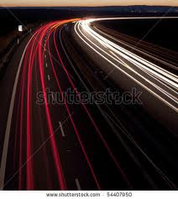
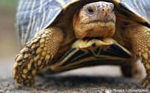
Which goes with whisked?

Slide 8
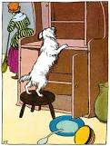
Which word goes with this picture? (curious, fascinated, whisked)
The dog was ____________ about the treats in the cabinet.

Slide 9
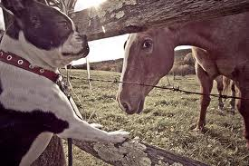
Which word goes with this picture? (curious, fascinated, whisked)
The dog was ______________ with the horse.

Slide 10
Which word goes with this picture? (curious, fascinated, whisked)

